Slide 1
::Computer Graphics Project(CS_1206):
Team Members:: | Registration Number::
Srikar Krishna | 14-1-5-091
Seetharam Naik | 14-1-5-097

Slide 2
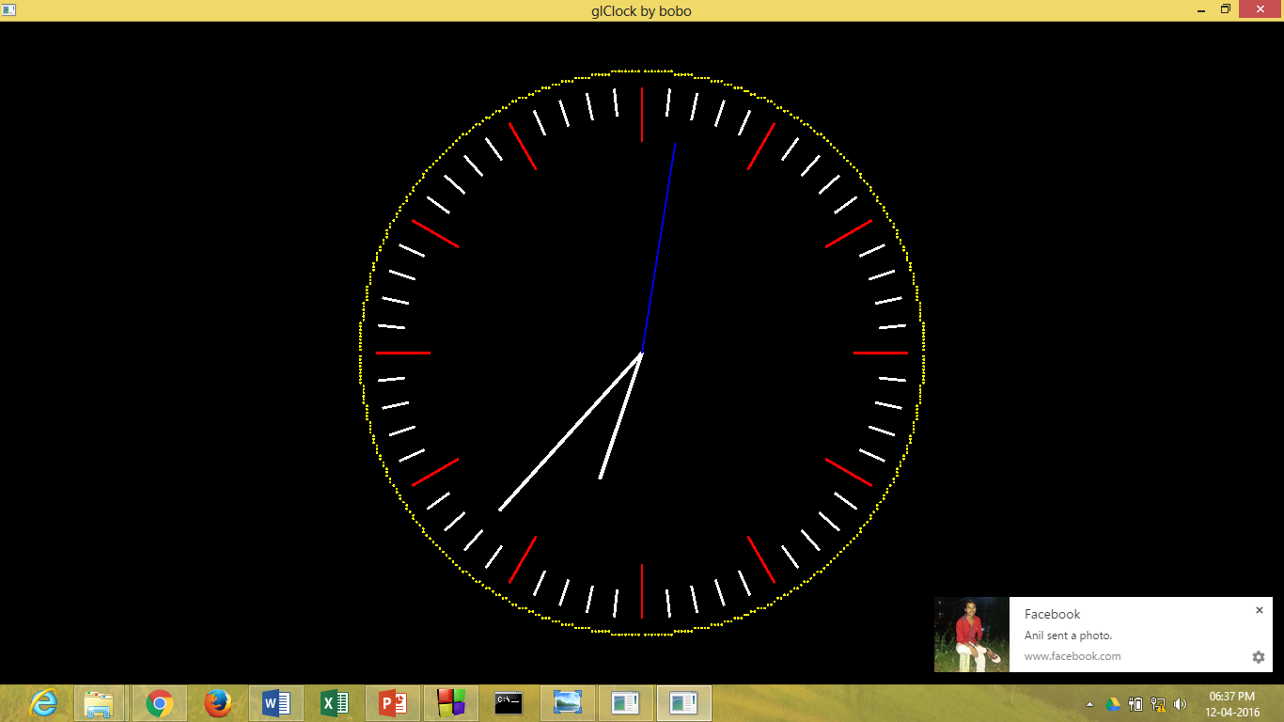
::Project Name:- Analog Clock::

Slide 3
The aim of this project is to implement an application package of Computer graphics using OpenGL. Here we represent the concepts displaying Analog clock in OpenGL.

Slide 4
The background color of the clock is black.
Red and white lines represents non numeric indicator marks.
It contains 3 needles one for hour, one for minute, and one for seconds.
Large needle represents minute, small needle represent hour and thin needle represent seconds.
There is a proper delay between needle moments and timings.
Needle moves from 1 to 12 in clockwise direction.

Slide 6
Software Requirements
To write, compile and link the program, a suitable C integrated development environment is required.
Code Blocks may be suitable in this regard.
Software requirements are:
1. Window Operating System & Code Blocks
2. Linux

Slide 7
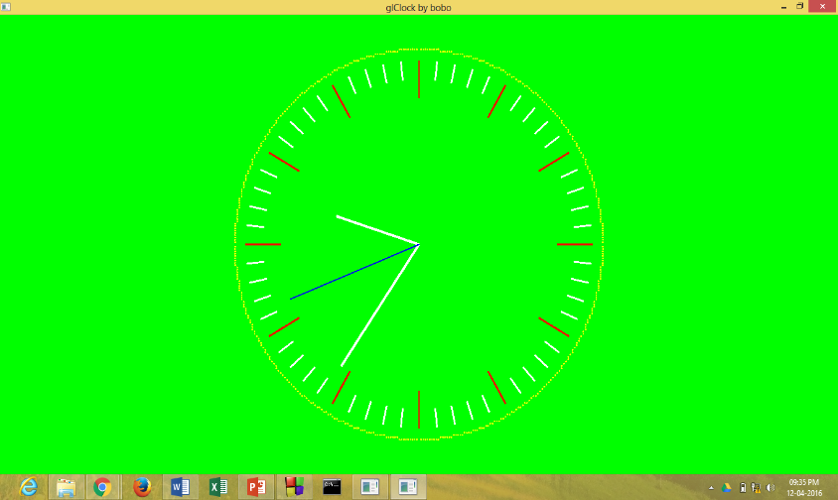
1.Changing the background color of Clock to green.

Slide 8
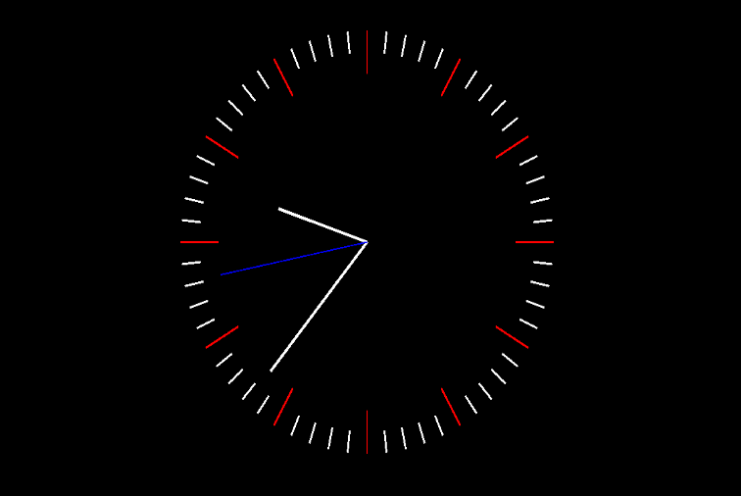
2.Removing the circle around the clock.

Slide 9
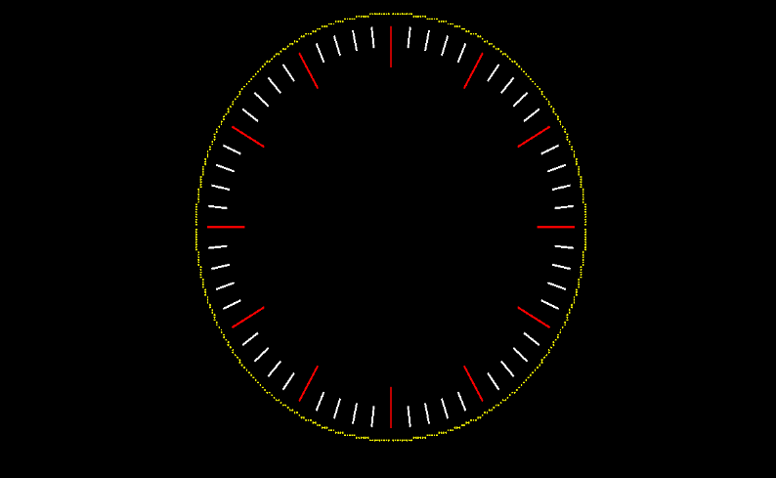
3. Removing hour, minutes & seconds hand .

Slide 10
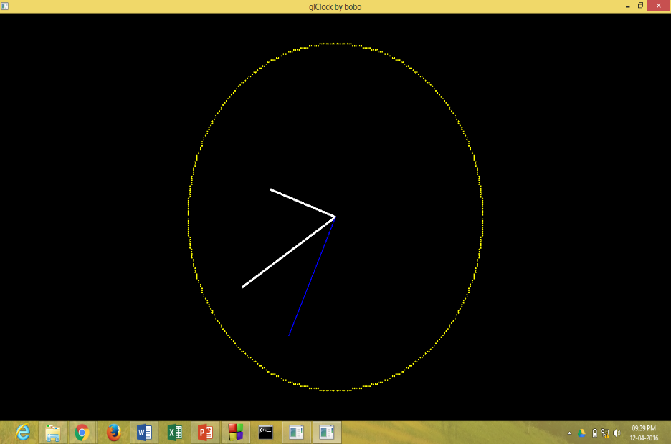
4.Removing the indicator marks.

Slide 11
Headers
Some of these library functions are contained in unique
C library header files such as
1)GL/glut.h
2)math.h
3)windows.h
4)time.h
5)sys/timeb.h

Slide 12
Functions Used
glutDisplayFunc(print_screen);
glutReshapeFunc(ChangeSize);
glutTimerFunc(33, TimerFunction, 1)

Slide 13
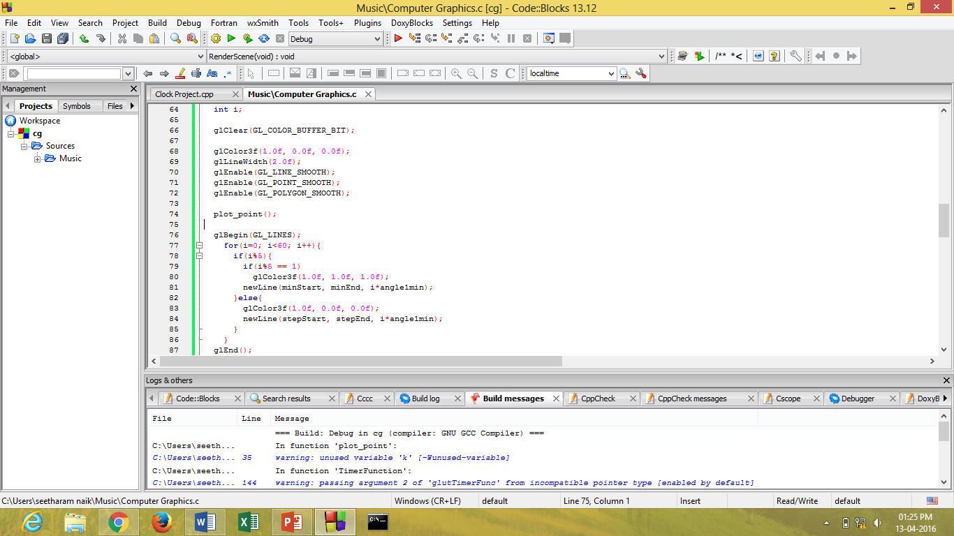
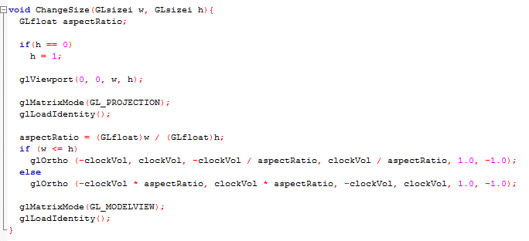
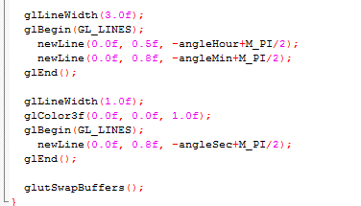
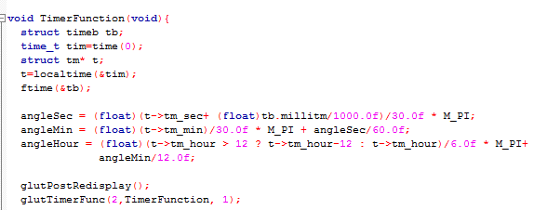

Slide 14
::CONCLUSION::
This project shows the graphical representation of a working analog clock.
The main objective of this program is to implement simple and basic functions of OpenGL.

Slide 15
THANK YOU
Sorry, if you have felt bored ;)

